Slide 1

MACHINE LEARNING
S1-23_AIMLCZG565
WEBINAR-3
BITS Pilani
BITS Pilani
Pilani Campus
Pilani Campus
Mrs. Abinaya Marimuthu I

Slide 2


BITS Pilani
Pilani|Dubai|Goa|Hyderabad
Decision Tree Classification Algorithm
2

Slide 3

Agenda
Introduction
Why Use Decision Tree
How does its works?
Attribute Selection Measures
Demo

Slide 4
Introduction
Decision Tree is a supervised learning technique that can be used for both classification and regression problems.
It is a tree structured classifier, where internal nodes represent the features of a dataset, branches represent the decision rules and each leaf node represents the outcome.
Decision nodes – used to make any decision and have multiple branches based on the given dataset
Leaf nodes – the output of those decisions and do not contain any branches.

Slide 5
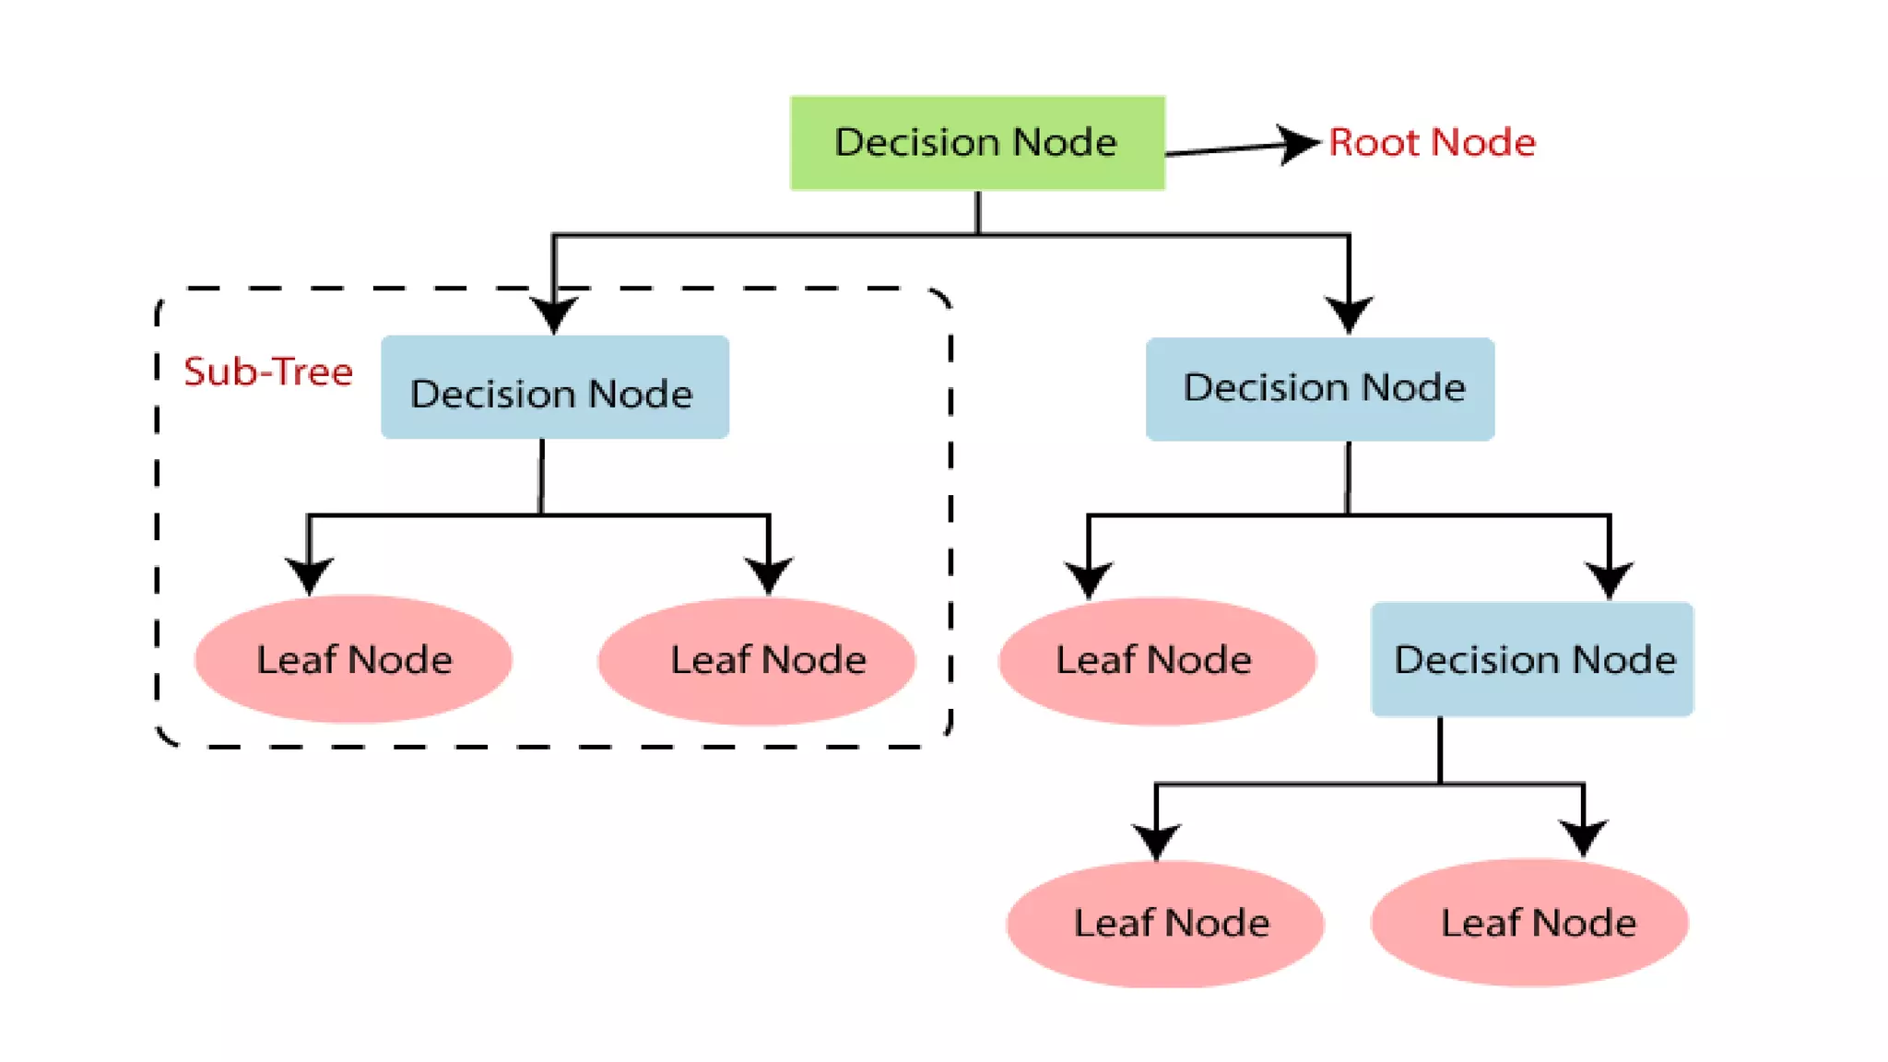
Introduction

Slide 6
Why use decision trees
Decision tree usually mimic human thinking while making a decision. So it is easy to understand
The logic behind the decision tree can be easily understood because it shows a tree like structure.
Terminologies:
Root node – represents entire dataset
Leaf node – Final output node
Splitting – process of dividing the decision node/ root node into sub nodes according to the given conditions.
Branch/Sud tree – Formed by splitting the tree
Pruning – process of removing the unwanted branches from the tree.
Parent/child node – The root is parent node. Other nodes are child node.

Slide 7
How does the decision tree works?
Step 1: Data Preprocessing: Clean and preprocess the data. Handle missing values and convert categorical variables into numerical representations if needed.
Step 2: Selecting the Root Node: Calculate the entropy of the target variable (class labels) based on the dataset. The formula for entropy is:
Entropy(S) = -Σ (p_i * log2(p_i))
where p_i is the proportion of instances belonging to class i.
Step 3: Calculating Information Gain: For each attribute in the dataset, calculate the information gain when the dataset is split on that attribute. The formula for information gain is:
Information Gain(S, A) = Entropy(S) - Σ ((|S_v| / |S|) * Entropy(S_v)), where S_v is the subset of instances for each possible value of attribute A, and |S_v| is the number of instances in that subset.
Step 4: Selecting the Best Attribute: Choose the attribute with the highest information gain as the decision node for the tree.
Step 5: Splitting the Dataset: Split the dataset based on the values of the selected attribute.
Step 6: Repeat the Process: Recursively repeat steps 2 to 5 for each subset until a stopping criterion is met (e.g., the tree depth reaches a maximum limit or all instances in a subset belong to the same class).

Slide 8
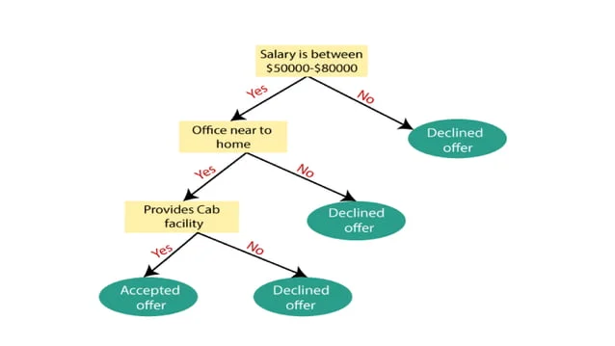
How does the decision tree works?
Example: there is a candidate who has a job offer and wants to decide whether he should accept the offer or Not. To solve this problem, the decision tree starts with the root node which taken Salary attribute by ASM.

Slide 9
Case Study
Weather Data Classification
predicting High_humidity in the weather based on the relative morning data like relative_humidity, air_temp etc.
Data was collected for a period of three years, from September 2011 to September 2014, to ensure that sufficient data for different seasons and weather conditions is captured.
this dataset was created to classify low-humidity days vs. non-low-humidity days (that is, days with normal or high humidity), the variables included are weather measurements in the morning, with one measurement, namely relatively humidity, in the afternoon.
The idea is to use the morning weather values to predict whether the day will be low-humidity or not based on the afternoon measurement of relative humidity.

Slide 10
Demo

Slide 11
Where can use Decision Tree
Classification Problems: Categorizing Emails, Medical Diagnosis, Credit Risk Assessment, Species Identification
Regression Problems: Predicting House Prices, Sales Forecasting, Crop Yield Prediction.
Business and Strategic Decision Making: Logistic Planning, Strategic Management, Risk Assessment

